Slide 1
Stacks
Presentation for use with the textbook Data Structures and Algorithms in Java, 6th edition, by M. T. Goodrich, R. Tamassia, and M. H. Goldwasser, Wiley, 2014

Slide 2
The Stack Abstract DataType
6.1.1

Slide 3
Abstract Data Types (ADTs)
An abstract data type (ADT) is an abstraction of a data structure
An ADT specifies:
Data stored
Operations on the data
Error conditions associated with operations

Slide 4
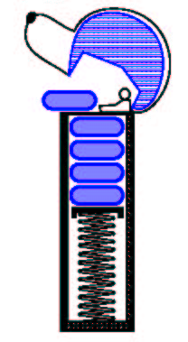
The Stack ADT
The Stack ADT stores arbitrary (not predefined) objects
Insertions and deletions follow the last-in first-out (LIFO) principle
Think of a spring-loaded plate dispenser
Main stack operations:
push(object): inserts an element
object pop(): removes and returns the last inserted element

Slide 5
The Stack ADT
Auxiliary stack operations:
object top() or peek(): returns the last inserted element without removing it
integer size(): returns the number of elements stored
boolean isEmpty(): indicates whether no elements are stored

Slide 6
Stack Interface in Java
Java interface corresponding to our Stack ADT
Assumes null is returned from top() and pop() when stack is empty
Different from the built-in Java class java.util.Stack

Slide 7
Stack Interface in Java
public interface Stack<E> {
int size();
boolean isEmpty();
E top();
void push(E element);
E pop(); }

Slide 8
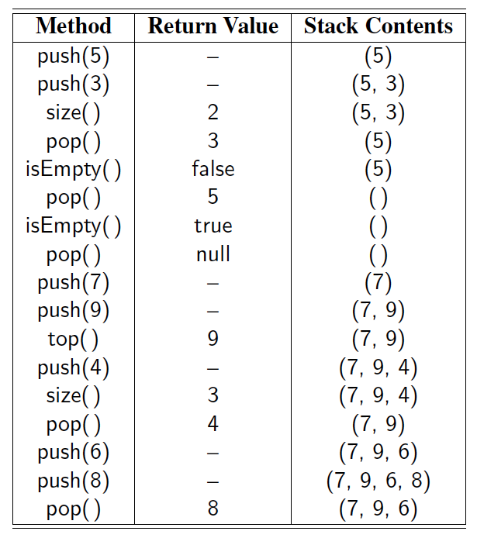
Example

Slide 9
Exceptions vs. Returning Null
Attempting the execution of an operation of an ADT may sometimes cause an error condition
Java supports a general abstraction for errors, called exception
An exception is said to be “thrown” by an operation that cannot be properly executed

Slide 10
Exceptions vs. Returning Null
In our Stack ADT, we do not use exceptions
Instead, we allow operations pop and top to be performed even if the stack is empty
For an empty stack, pop and top simply return null

Slide 11
Applications of Stacks
Direct applications
Page-visited history in a Web browser
Undo sequence in a text editor
Chain of method calls in the Java Virtual Machine

Slide 12
Method Stack in the JVM
The Java Virtual Machine (JVM) keeps track of the chain of active methods with a stack
main() { int i = 5; foo(i); }
foo(int j) { int k; k = j+1; bar(k); }
bar(int m) { … }

Slide 13
Method Stack in the JVM
When a method is called, the JVM pushes on the stack a frame containing
Local variables and return value
Program counter, keeping track of the statement being executed
main() { int i = 5; foo(i); }
foo(int j) { int k; k = j+1; bar(k); }
bar(int m) { … }
bar
PC = 1 m = 6
foo
PC = 3 j = 5
k = 6
main
PC = 2 i = 5

Slide 14
Method Stack in the JVM
When a method ends, its frame is popped from the stack and control is passed to the method on top of the stack
Allows for recursion
main() { int i = 5; foo(i); }
foo(int j) { int k; k = j+1; bar(k); }
bar(int m) { … }
bar
PC = 1 m = 6
foo
PC = 3 j = 5
k = 6
main
PC = 2 i = 5

Slide 15
A Simple Array-Based Stack
6.1.2

Slide 16
Array-based Stack
A simple way of implementing the Stack ADT uses an array
We add elements from left to right
A variable keeps track of the index of the top element
Algorithm size()
return t + 1
Algorithm pop()
if isEmpty() then
return null
else
t ← t − 1
return S[t + 1]
…
S
0
1
2
t

Slide 17
Array-based Stack (cont.)
The array storing the stack elements may become full
A push operation will then throw a FullStackException
Limitation of the array-based implementation
Not intrinsic to the Stack ADT
Algorithm push(o)
if t = S.length − 1 then
throw IllegalStateException
else
t ← t + 1
S[t] ← o
…
S
0
1
2
t

Slide 18
Performance and Limitations
Performance
Let n be the number of elements in the stack
The space used is O(n)
Each operation runs in time O(1)
Limitations
The maximum size of the stack must be defined a priori and cannot be changed
Trying to push a new element into a full stack causes an implementation-specific exception

Slide 19
Array-based Stack in Java
public class ArrayStack<E> implements Stack<E> {
// holds the stack elements private E[ ] S;
// index to top element private int top = -1;
// constructor public ArrayStack(int capacity) { S = (E[ ]) new Object[capacity]); }
public E pop() { if isEmpty() return null; E temp = S[top]; // facilitate garbage collection: S[top] = null; top = top – 1; return temp; }
… (other methods of Stack interface)

Slide 20
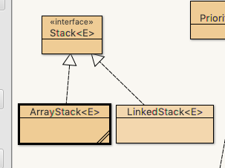
Stack Array Example
Open with BlueJ
file ArrayStack.java

Slide 21
Implementing a Stack with a Singly Linked List
6.1.3

Slide 22
Implementing a Stack with a Singly Linked List
We saw stack implemented with an array
A stack can also be implemented with a singly linked list
Choice:
Top of stack at beginning of list?
Top at end of list?
Top at beginning: constant-time operations

Slide 23
Adapter Pattern
A basic design pattern is the adapter
A class already exists that provides most or all of the functionality you need
Write a new adapter class that wraps the function of the existing class
Provide a new ”store front” for the advertised functionality

Slide 24

Adapter Pattern
Adapter Pattern:
Something is already made for one purpose, but an adapter is added to use in a similar purpose.
This Photo by Unknown Author is licensed under CC BY-SA

Slide 25

Adapter Pattern: Stack Wraps SLL
Stack Class
Singly Linked List

Slide 26
Adapter Pattern: Stack Wraps SLL
A stack implemented by wrapping a class around singly-linked list
Stack Method | Singly Linked List Method
size() | list.size()
isEmpty() | list.isEmpty()
push(e) | list.addFirst(e)
pop() | list.removeFirst()
top() | list.first()

Slide 27
LinkedStack Class

Slide 28
Reversing An Array
6.1.4

Slide 29
Example Use in Java
public class Tester {
// … other methods public intReverse(Integer a[]) { Stack<Integer> s; s = new ArrayStack<Integer>();
… (code to reverse array a) … }
public floatReverse(Float f[]) { Stack<Float> s; s = new ArrayStack<Float>();
… (code to reverse array f) … }

Slide 30
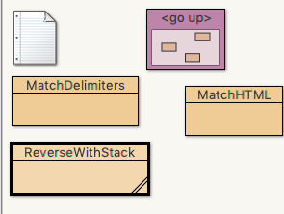
Reversing Array Example
Open up DSAJ-sourcecode with BlueJ
find package dsaj.stacks
open
file ReverseWithStack.java

